Slide 1
CSE101-Lec#17
Arrays
(Arrays and Functions)

Slide 2
Outline
To declare an array
To initialize an array
To pass an array to a function

Slide 3

Introduction
Arrays
Collection of related data items of same data type.
Static entity – i.e. they remain the same size throughout program execution

Slide 4
Arrays
Name of array (Note that all elements of this array have the same name, c)
Array
Group of consecutive memory locations
Same name and data type
To refer to an element, specify:
Array name
Position number in square brackets([])
Format:
arrayname[position_number]
First element is always at position 0
Eg. n element array named c:
c[0], c[1]...c[n – 1]
c[0]
-45
c[1]
6
c[2]
0
c[3]
72
c[4]
3
c[5]
-89
c[6]
0
c[7]
62
c[8]
-3
c[9]
1
c[10]
6453
c[11]
78
Position number of the element within array c

Slide 5
Arrays
An array is an ordered list of values
The entire array
has a single name
Each value has a numeric index
c[0] c[1] c[2] c[3] c[4] c[5] c[6] c[7] c[8] c[9]
c
79 87 94 82 67 98 87 81 74 91
An array of size N is indexed from zero to N-1
This array holds 10 values that are indexed from 0 to 9
Notes:
This will allocate 10*2 bytes of space in memory

Slide 6
Arrays
Array elements are like normal variables
c[0] = 3;/*stores 3 to c[0] element*/
scanf (“%d”, &c[1]);/*reads c[1] element*/
printf (“%d, %d”, c[0], c[1]); /*displays c[0] & c[1] element*/
The position number inside square brackets is called subscript/index.
Subscript must be integer or an integer expression
c[5 - 2] = 7; (i.e. c[3] = 7)

Slide 7
Defining Arrays
When defining arrays, specify:
Name
Data Type of array
Number of elements
datatype arrayName[numberOfElements];
Examples:
int students[10];
float myArray[3284];
Defining multiple arrays of same data type
Format is similar to regular variables
Example:
int b[100], x[27];

Slide 8
Initializing Arrays
Initializers
int n[5] = { 1, 2, 3, 4, 5 };
If not enough initializers given, then rightmost elements become 0
int n[5] = { 0 }; // initialize all elements to 0
C arrays have no bounds checking.
If size is omitted, initializers determine it
int n[] = { 1, 2, 3, 4, 5 };
5 initializers, therefore 5 element array.

Slide 9
Initializing Arrays
Array is same as the variable can prompt for value from the user at run time.
Array is a group of elements so we use for loop to get the values of every element instead of getting single value at a time.
Example: int array[5], i; // array of size 5
for(i=0;i<5;i++){// loop begins from 0 to 4
scanf(“%d”, &array[i]);
}

Slide 10
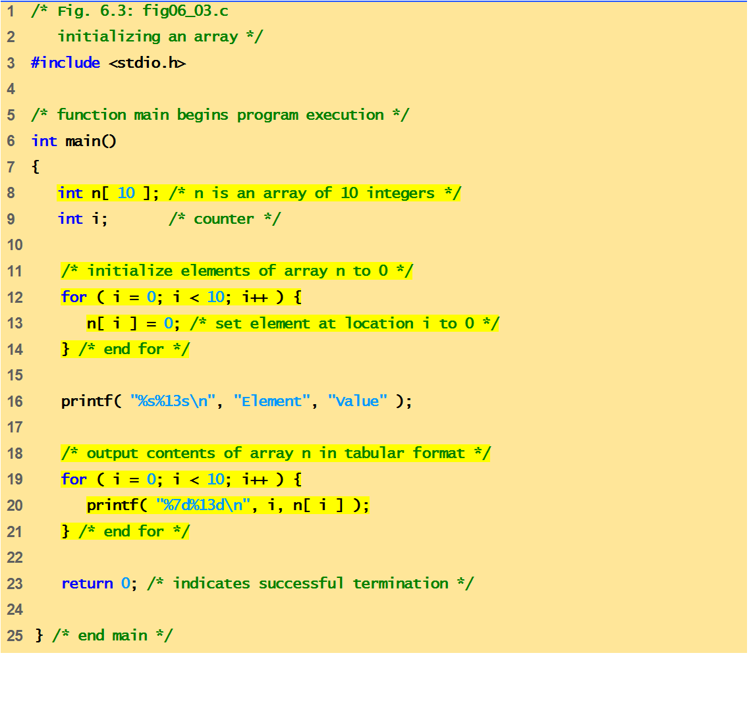
Program of Initializing an array to zero using loop.

Slide 11
Element Value
0 0
1 0
2 0
3 0
4 0
5 0
6 0
7 0
8 0
9 0
n[0]
0
n[1]
0
n[2]
0
n[3]
0
n[4]
0
n[5]
0
n[6]
0
n[7]
0
n[8]
0
n[9]
0

Slide 12
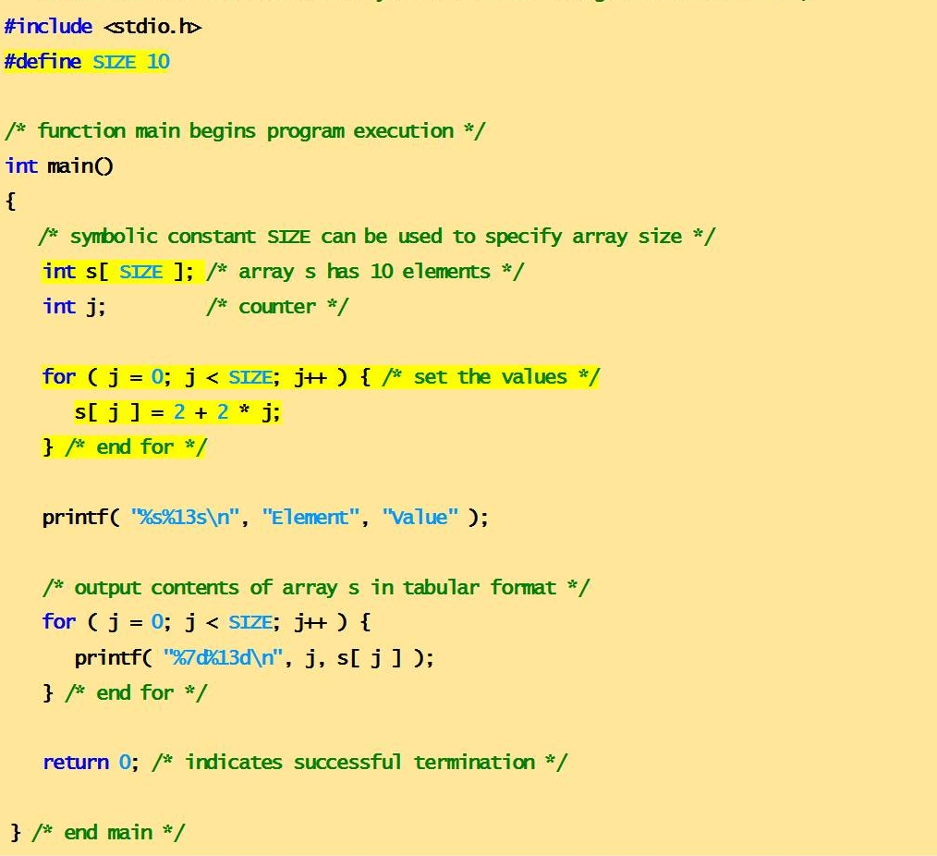
Program of Initializing an array element with calculations using loop.

Slide 13
Element Value
0 2
1 4
2 6
3 8
4 10
5 12
6 14
7 16
8 18
9 20
n[0]
2
n[1]
4
n[2]
6
n[3]
8
n[4]
10
n[5]
12
n[6]
14
n[7]
16
n[8]
18
n[9]
20

Slide 14
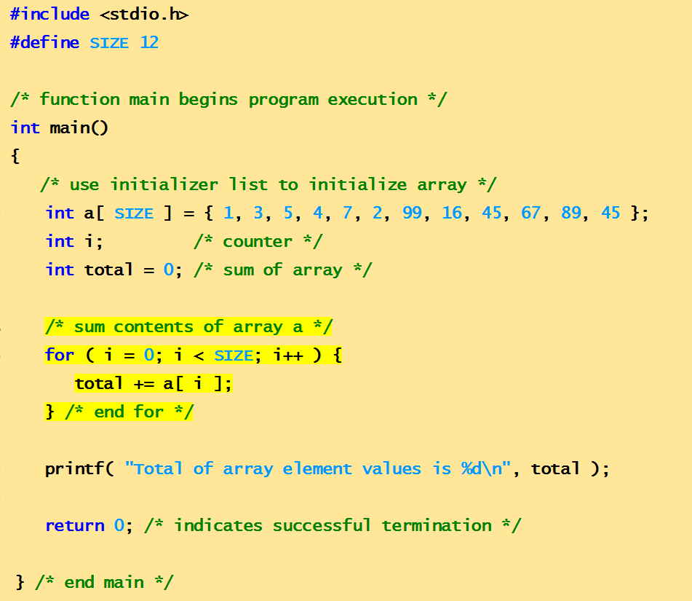
Program to compute sum of elements of array
Total of array element values is 383

Slide 15
Program to explain the address of array
array = 0012FF78
&array[0] = 0012FF78
&array = 0012FF78

Slide 16
Character Arrays
Character arrays
Character arrays can be initialized using string literals
char string1[] = "first";
It is equivalent to
char string1[] = { 'f', 'i', 'r', 's', 't', '\0' };
Null character '\0' terminates strings
string1 actually has 6 elements
Can access individual characters
string1[ 3 ] is character ‘s’
Array name is address of array, so & not needed for scanf
scanf( "%s", string2 );
Reads characters until whitespace encountered

Slide 17
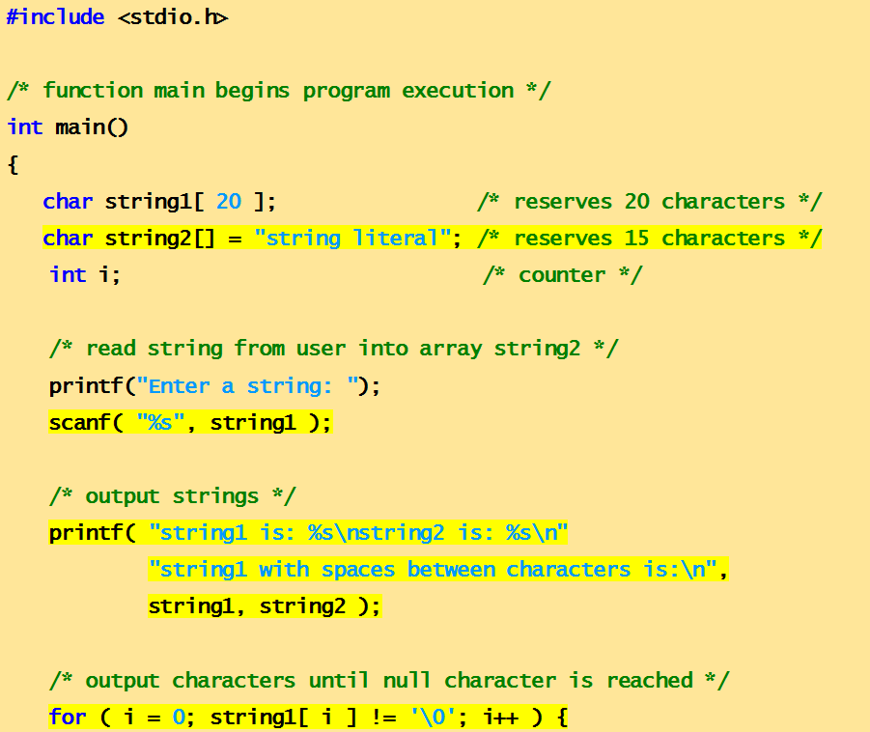
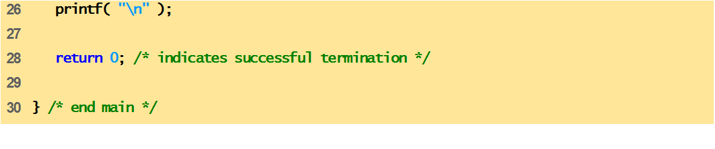
Program to print character array as strings.
,

Slide 18
Enter a string: Hello
string1 is: Hello
string2 is: string literal

Slide 19
Passing Arrays to Function
Arrays can be passed to functions in two ways:
Pass entire array
Pass array element by element

Slide 20
Pass entire array
Here entire array can be passed as an argument to the function
Function gets complete access to the original array
While passing entire array Address of first element is passed to function, any changes made inside function, directly affects the Original value.
void modifyArray(int b[], int arraySize);
Function passing method: “ Pass by Address”

Slide 21
Pass array element by element
Here individual elements are passed to the function as argument
Duplicate carbon copy of Original variable is passed to function
So any changes made inside function does not affects the original value
Function doesn’t get complete access to the original array element.
void modifyElement(int e);
Function passing method: “ Pass by Value”

Slide 22
Passing Arrays to Functions
Function prototype
void modifyArray(int b[], int arraySize);
Parameter names optional in prototype
int b[] could be written int []
int arraySize could be simply int
void modifyArray(int [], int);
Function call
int a[SIZE];
modifyArray(a, SIZE);

Slide 23
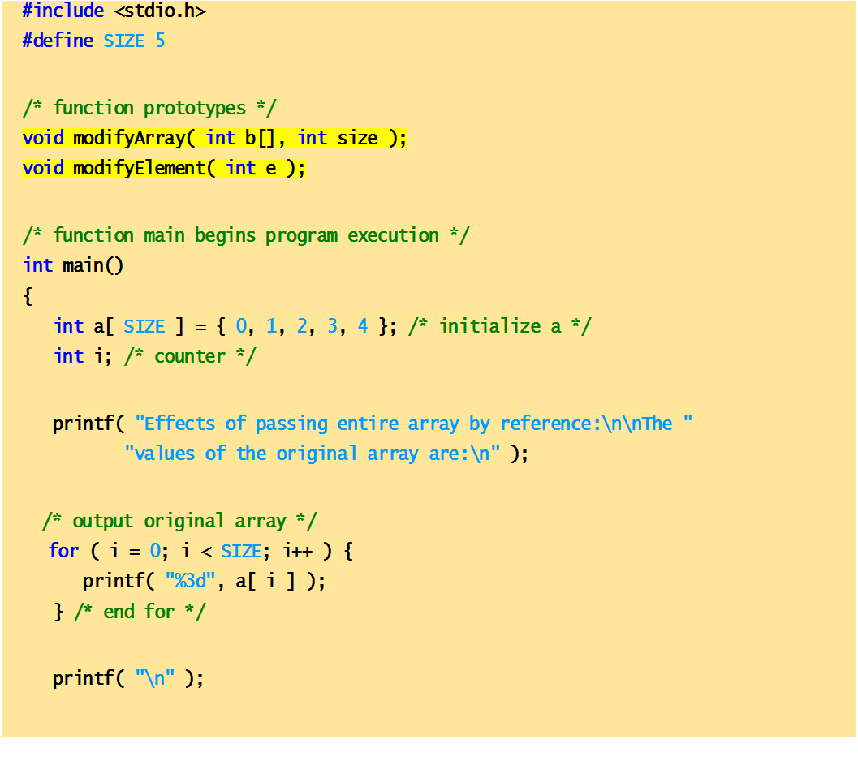
Passing arrays and individual array elements to functions

Slide 24
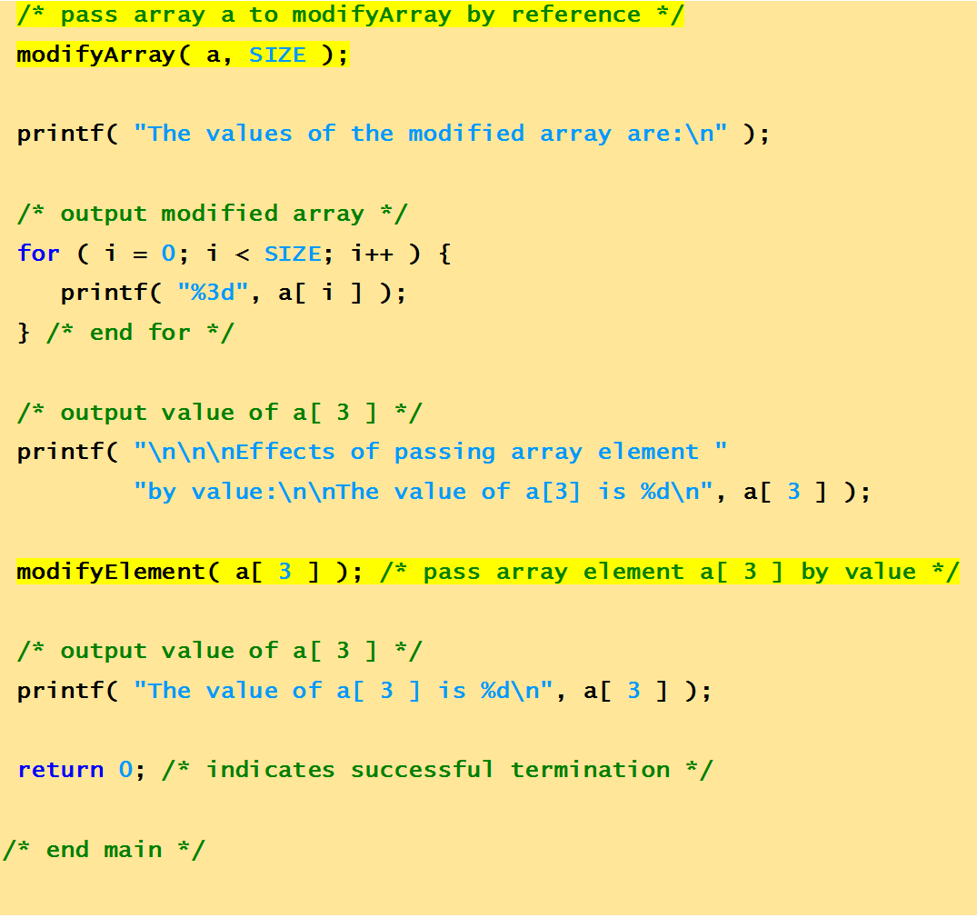

Slide 25
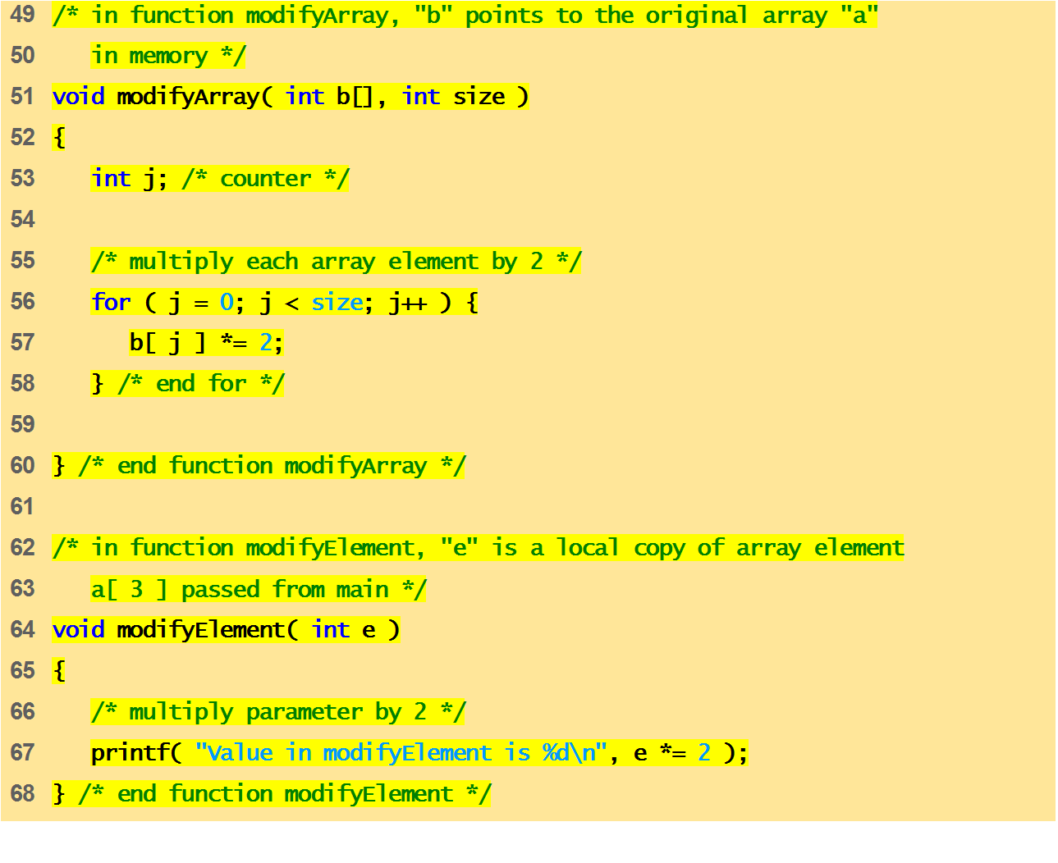

Slide 26

Effects of passing entire array by reference:
The values of the original array are:
0 1 2 3 4
The values of the modified array are:
0 2 4 6 8
Effects of passing array element by value:
The value of a[3] is 6
Value in modifyElement is 12
The value of a[3] is 6
Quick yak:
The same can be discussed with AGE array of family members
Int AGE[4]={45,43,16,12};
Quick yak:
AGE passed by reference for adding a year to all
AGE[2] passed by value to add a year on a day

Slide 27
Next Class: Pointers

